Slide 1

The Art and Science of Model-Driven App Design
POWER PLATFORM

Slide 2

Mitch Milam
mitch@xrmcoaches.com
@mitchmilam
linkedin.com/in/mitchmilam
youtube.com/xRMCoaches
Subscribe!

Slide 3
Dynamics 365 Training
http://learn.xrmcoaches.com
JavaScript Training
Free and Paid courses

Slide 4
Next Webinar
The Art and Science of Model-Driven App Design

Slide 5
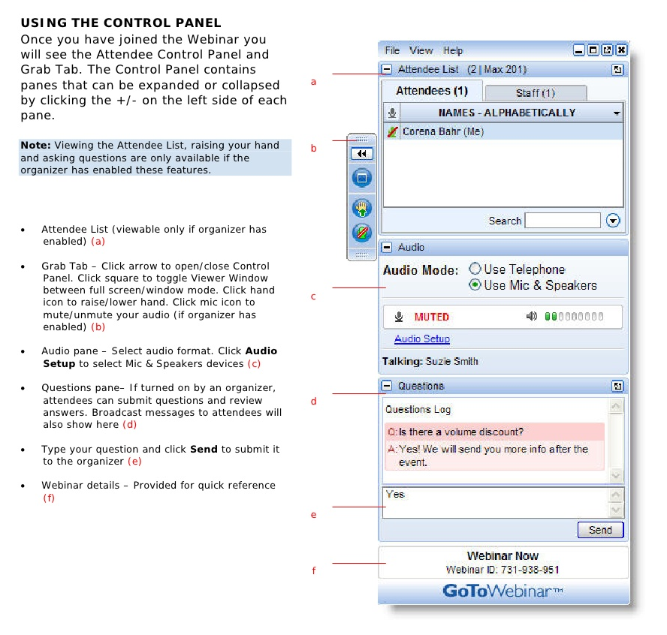
Webinar Housekeeping

Slide 6
Overview

Slide 7
Is it Art or is it Science?
Maybe it is some of both?

Slide 8
It is all about the user
…

Slide 9
UCI Only
It is no longer the future

Slide 10
Device Platform
And their impact on your solution

Slide 11
Tools and Resources
…

Slide 12
Tools
Ribbon Workbench
SnapShot!
XrmToolbox Attribute Usage Inspector

Slide 13
Resources
Eliminating Technical Debt webinar
Join the PCF Revolution webinar

Slide 14
New Features
And their impact on your solution

Slide 15
The What: Technical Aspects

Slide 16
Apps
…

Slide 17
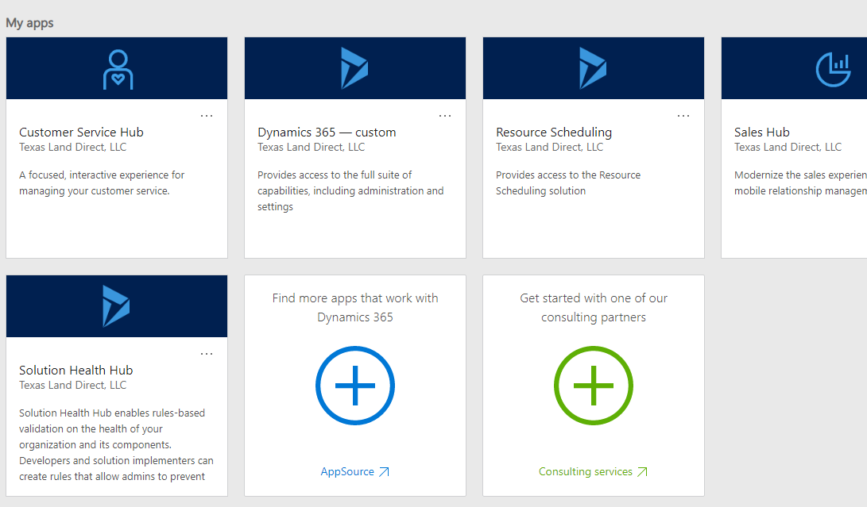
App Launcher

Slide 18
App Creation
When to use
When to have more than one
Visibility by Security roles
Instead of an entire App, maybe use SiteMap Areas

Slide 19
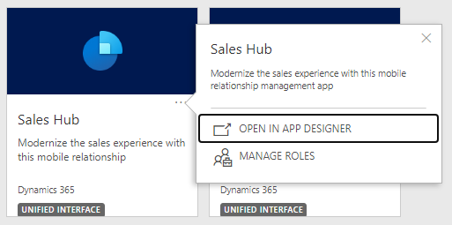
Apps and Security Roles

Slide 20
SiteMap
…

Slide 21
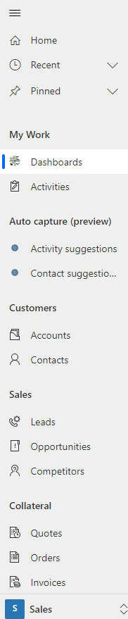
SiteMap

Slide 22
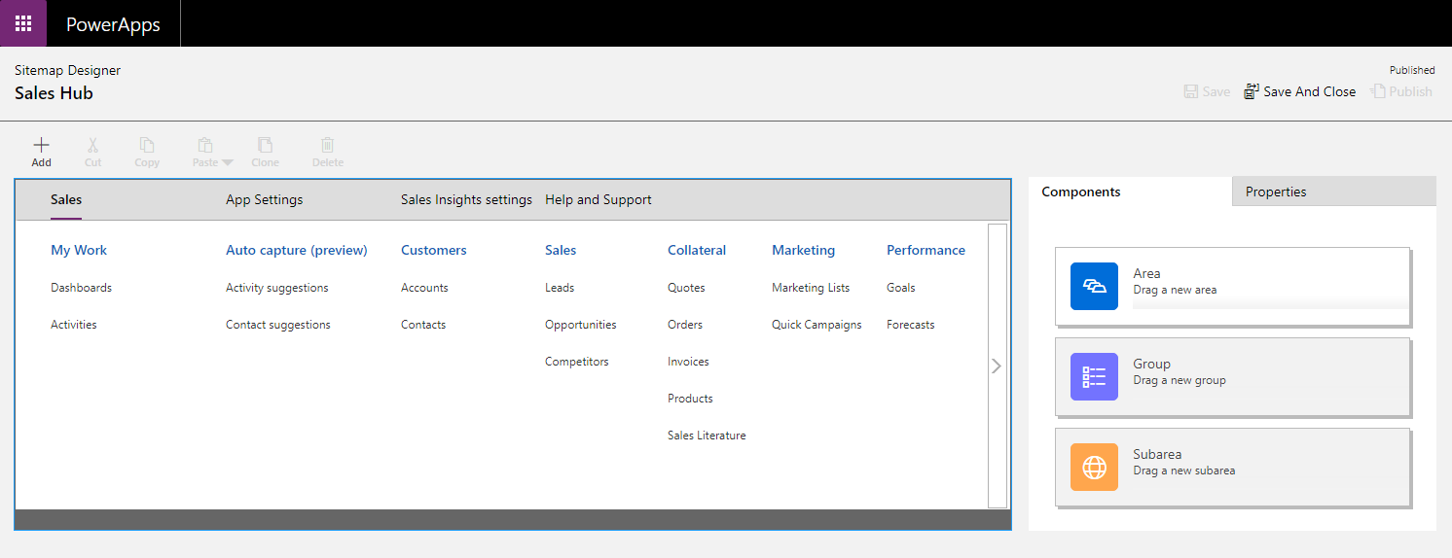
SiteMap Designer

Slide 23
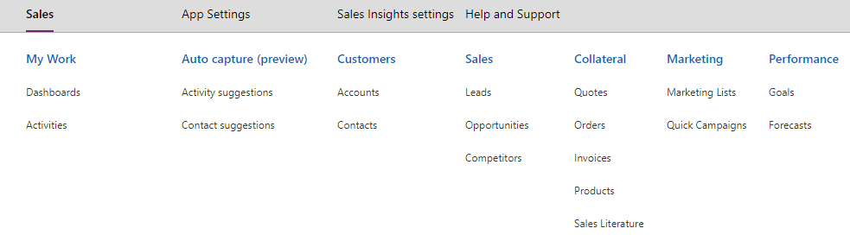
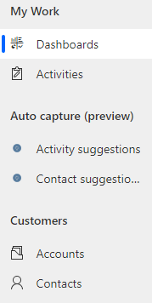
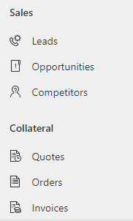
SiteMap Designer

Slide 24
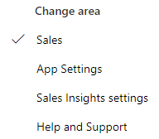
SiteMap Designer

Slide 25
Themes
…

Slide 26
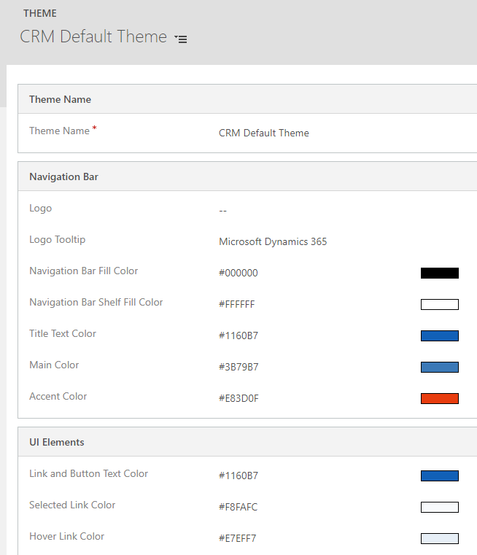
Themes

Slide 27
Dashboards
…

Slide 28
Dashboards
Built-In
Power BI
Hybrid

Slide 29
Views
…

Slide 30
Views
Relevant to the job or task at hand
Can you make the data fit onto one page without scrolling horizontally?

Slide 31
Forms
…

Slide 32
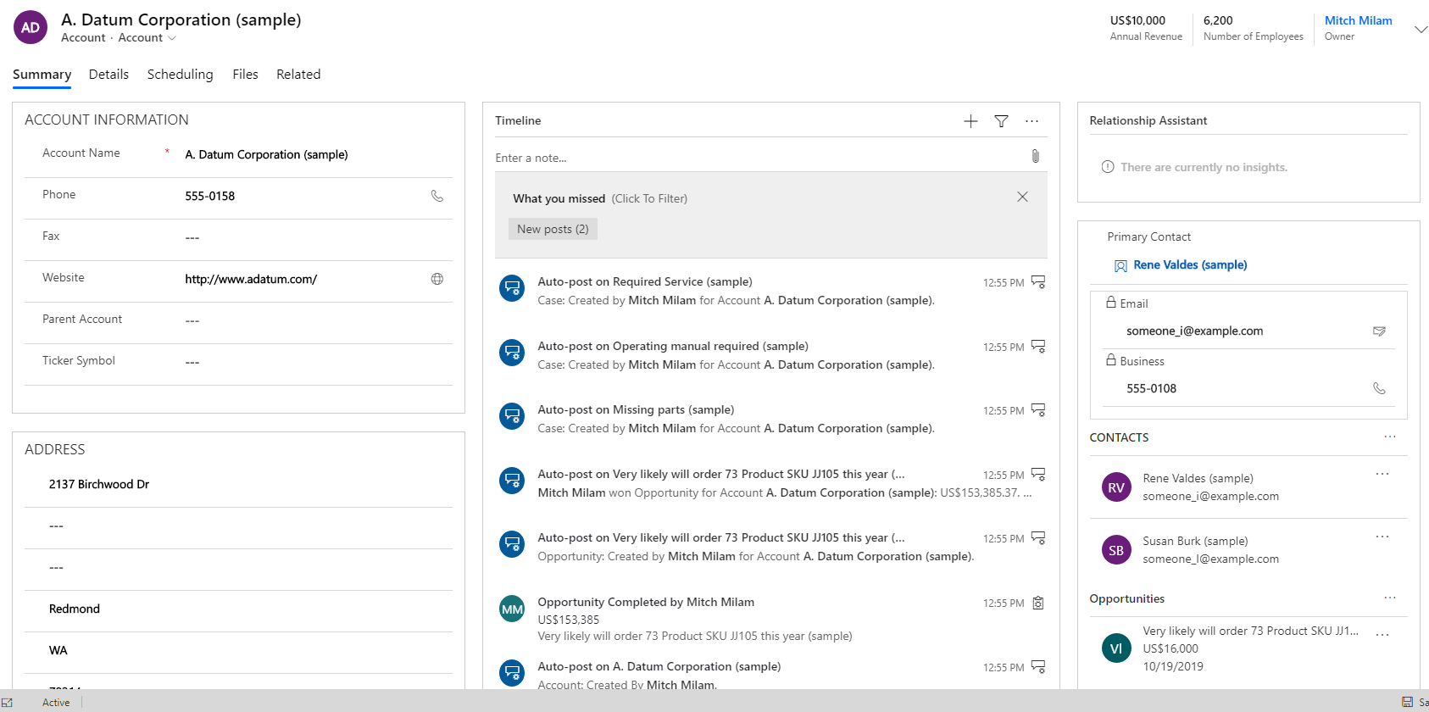
Form Design

Slide 33
Form Components
Header and Footer
Tabs
Sections
Fields
Relationships

Slide 34
General Guidelines
Show the user the information they need when they need it
Simplicity is the best
Complicated layouts decrease productivity

Slide 35
Considerations
Move the Timeline to its own tab
Try to design the tabs to keep people from scrolling
Show Tabs, Sections, Fields only when necessary
Form or Field notifications
Align tabs with business process flows

Slide 36
Considerations
Use security roles to show/hide controls
There is a lot of personal preferences involved
Sometimes users do not know what they want until they see it
Iterate, iterate, iterate
The Summary tab, is just that: Summary information. Put other data on other tabs

Slide 37
Considerations
Bling vs Functionality
Just because you can do a thing, does not mean that you should do a thing

Slide 38
Command Bar / Ribbon
…

Slide 39
Command Bar
Mostly controlled through security roles
Use the Ribbon Editor to make additional modifications
Don’t go crazy

Slide 40
Business Process Flows
…

Slide 41
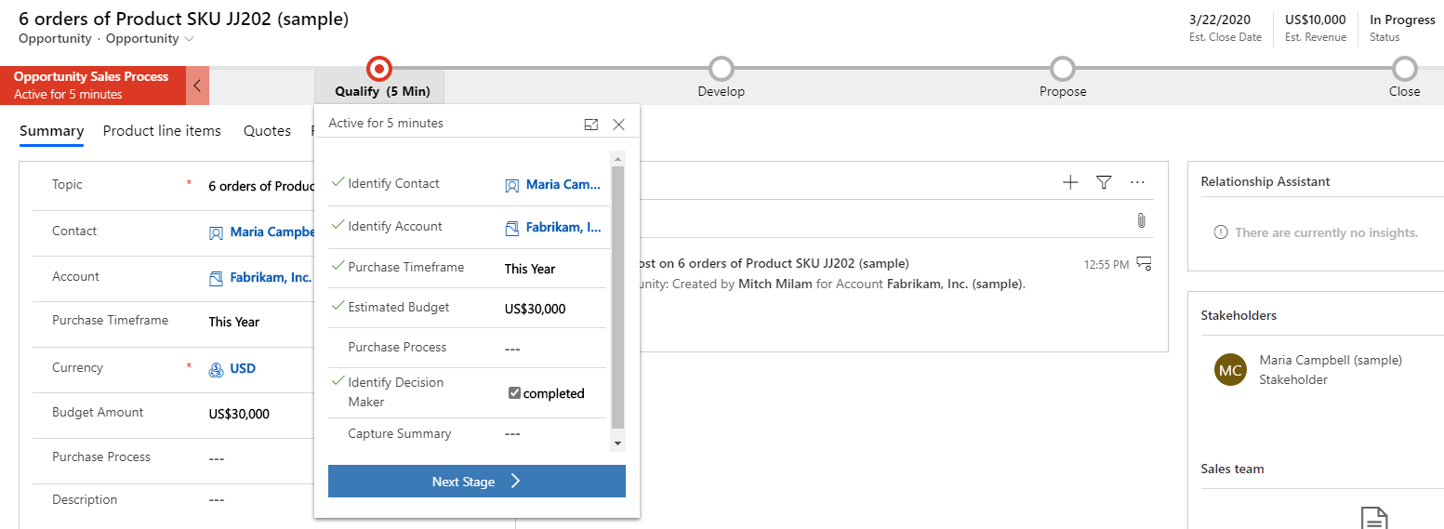
Business Process Flows

Slide 42
Business Process Flows
Do you have a process
Is it followed consistently
Will using a BPF make users more efficient?
Will using a BPF make the data more consistent?

Slide 43
Implementation

Slide 44
Testing
…

Slide 45
Iterate Iterate Iterate
Do
Test
Do some more
Test some more

Slide 46
Deployment
…

Slide 47
Deployment Strategy
Iterative
Waterfall

Slide 48
Communication
Keep your users involved
Keep your users informed

Slide 49
Walk-Through

Slide 50
Reimagining the Account
…

Slide 51
App Design Course
https://learn.xrmcoaches.com/courses/appdesign
Officially opens on: 1 March 2020
Introductory pricing of $97
After 1 March, the normal price will be $197

Slide 52
Questions?

Slide 53
Thank You

